Slide 1

Data-Driven Optimization and Scalability of Diabetes Care Medical and General Stores in Retail Pharmacy sector
ARYA MULAY
23F3002123
IITM Online BS Degree Program,
Indian Institute of Technology, Madras, Chennai
Tamil Nadu, India, 600036

Slide 2
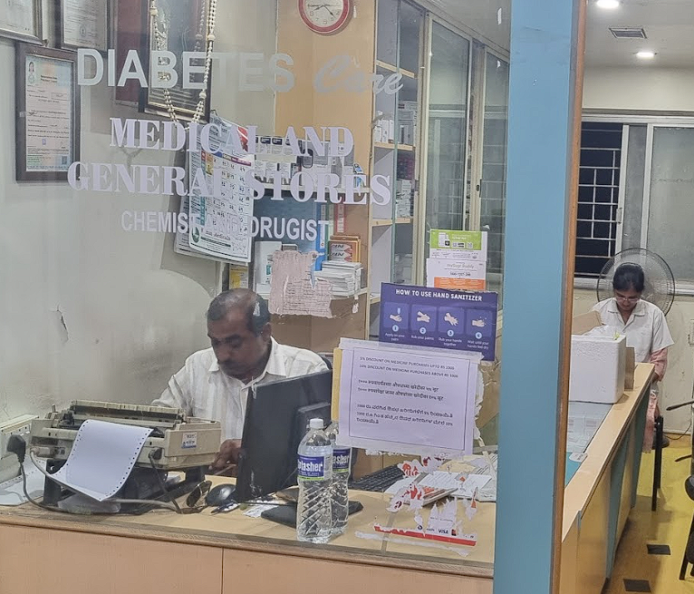
ABOUT THE FIRM
Retail pharmacy established in 2010
Primary focus: Diabetes care & general medicines
Operates as a single-branch pharma firm
Serves a stable local customer base
Uses legacy Green Cross database software with limited analytical capability
Has Strong Supplier Relations built over past 15 years

Slide 3
PROBLEM STATEMNETS FORMULATED
Scalability & Capital Utilization
Inventory Management Inefficiency
Profitable business unable to scale
New branch not opened despite demand
Supplier credit not optimally utilized
Working capital remains locked
Expansion decisions not data-driven
Frequent overstocking of slow-moving items
Stockouts of high-demand medicines
Purchasing based on manual judgment
No statistical reorder policy
Capital trapped in inventory

Slide 4
PRIMARY DATA COLLECTION
Raw Data Collected
Final Processed Data
Inventory & sales data - inventory_sales.xlsx
Purchase & GST data - purchase_and_gst.xlsx
Monthly files consolidated
Units standardized (e.g., strips, rupee(₹))
Cleaned datasets used for analysis
Primary operational data collected
Source: Green Cross database software
Period: April 2024 – January 2025 (10 months)
Data exported as CSV / system reports

Slide 5
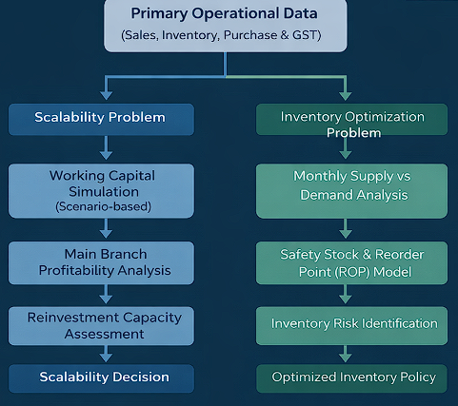
METHODOLOGY
Problem Statement 1: Scalability
Working capital simulation (scenario based)
Main branch profitability analysis
Problem Statement 2: Inventory Optimization
Monthly supply vs demand analysis
Safety Stock & Reorder Point (ROP) model

Slide 6
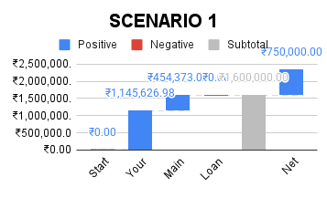
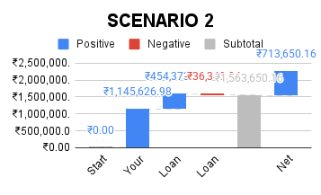
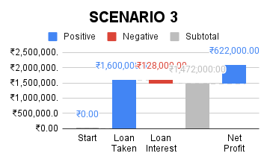
RESULTS AND FINDINGS
Working Capital Flow Simulation
Scenario 1 (Trapped+Profit)
Scenario 2 (Trapped+Loan)
Scenario 3 (Fully Loaned)
Scenario 1 is the most optimal as it maximizes profit while minimizing financial risk by avoiding external borrowing and interest costs by maintaining an ROI of 46.88%

Slide 7
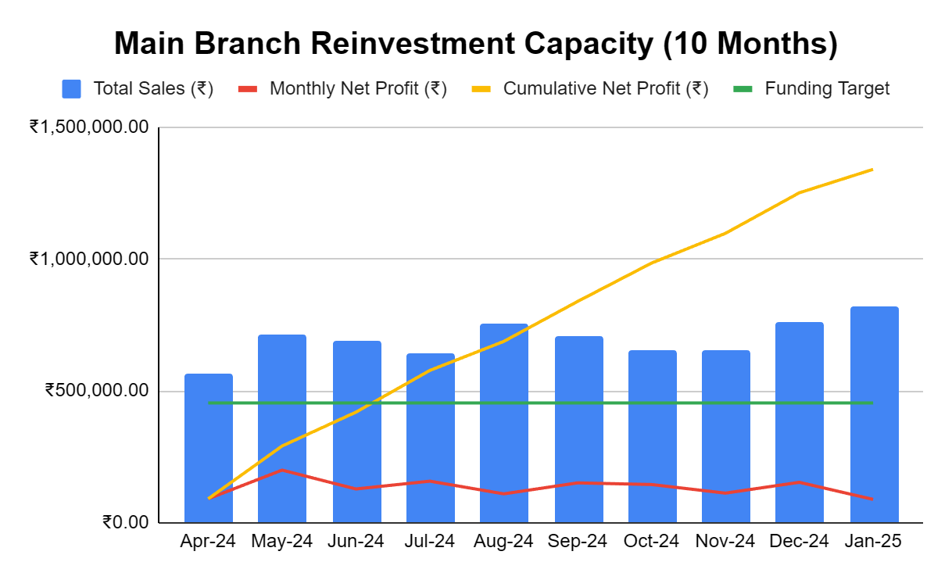
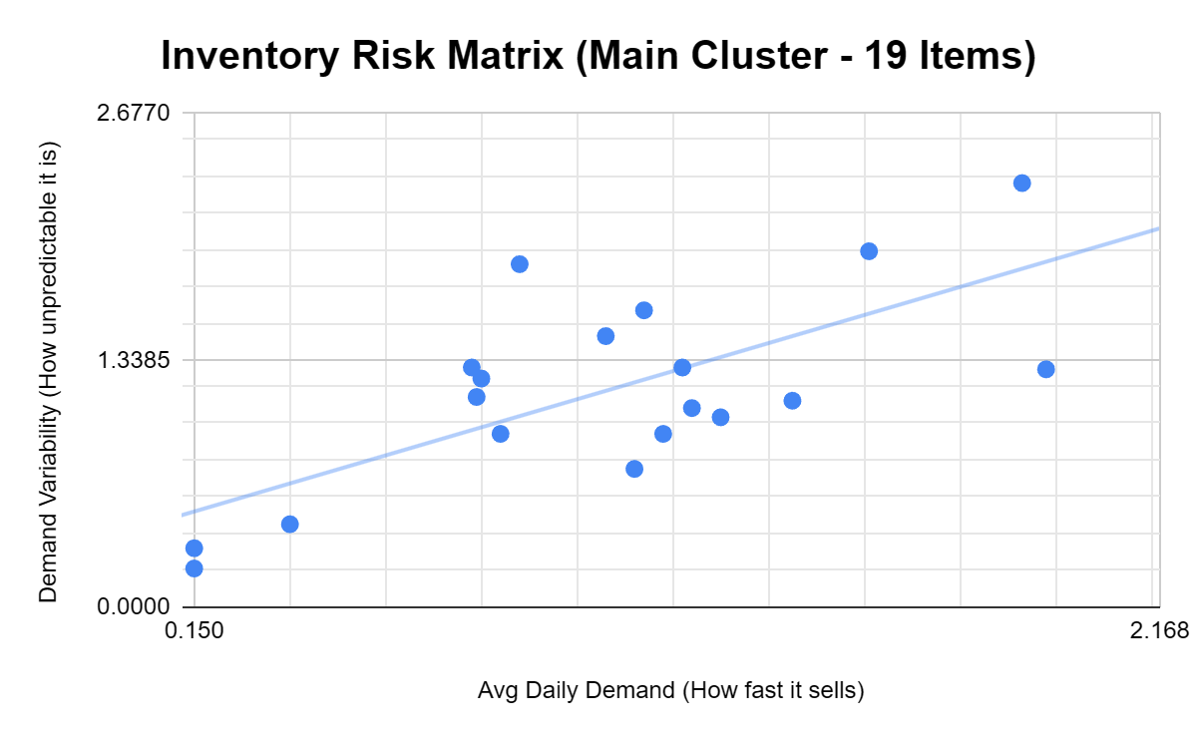
RESULTS AND FINDINGS
Main Branch Reinvestment Capacity
Return Order Point (ROP) Model
Inventory demand shows high variability across products
ROP model prioritizes items based on demand risk
Enables data-driven reorder decisions
Note: METSMALL 500 mg excluded due to extreme outlier behavior, which would mask risk patterns of other items.
Main branch generates consistent monthly surplus
Cumulative profit exceeds funding target within 10 months
Expansion is self-funded without external borrowing

Slide 8
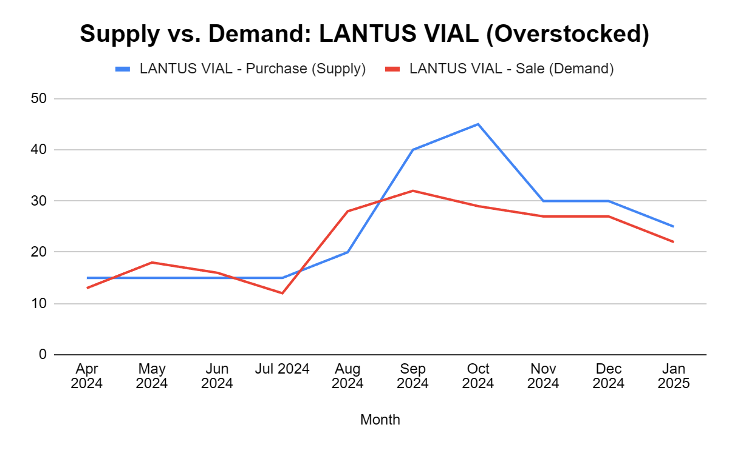
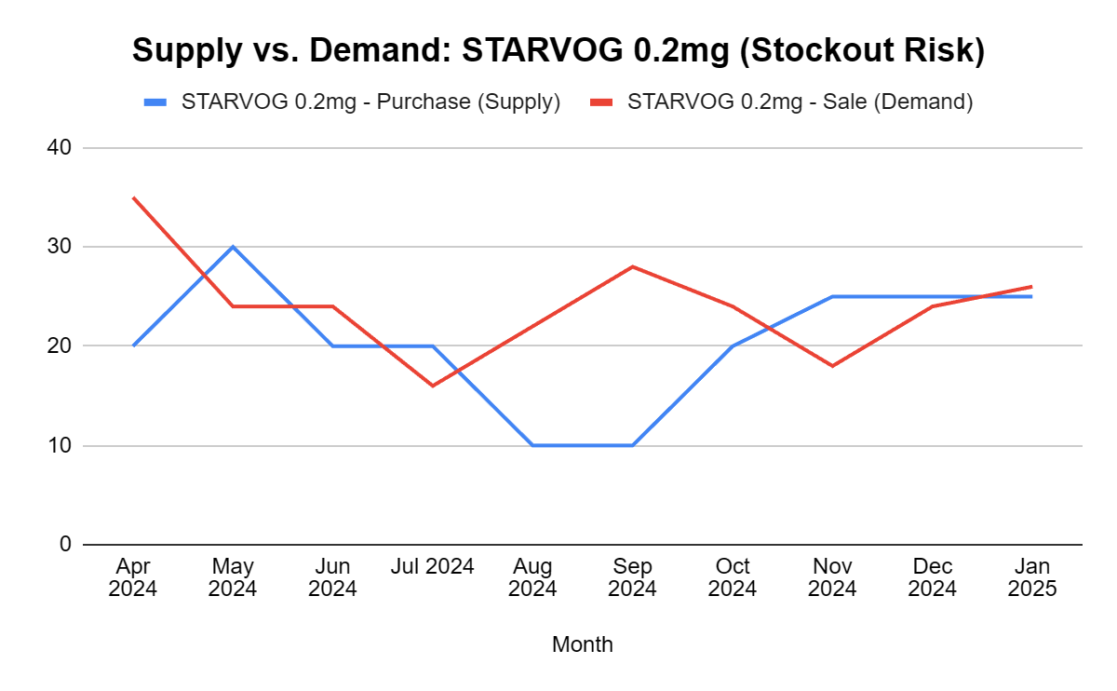
RESULTS AND FINDINGS
Monthly Supply vs. Demand Imbalance
LANTUS VIAL (Overstocked)
Supply consistently exceeds demand
Leads to inventory accumulation
Causes working capital lock-in
STARVOG 0.2 mg (Stockout Risk)
Demand frequently exceeds supply
High risk of stockouts
Results in lost sales opportunities

Slide 9
INTERPRETATIONS AND RECOMMENDATIONS
Scalability & Capital Utilization
Inventory Management Inefficiency
Adopt Scenario 1 as the funding strategy
Reinvest main branch surplus for expansion
Implement ROP-based inventory policy
Reduce overstock in slow-moving items
Prioritize replenishment for high-demand medicines
Business is profitable but capital constrained
Expansion feasibility depends on efficient capital utilization
Inventory inefficiencies lock working capital
Manual purchasing drives overstocking and stockouts

Slide 10
CONCLUSION
Data-driven analysis unlocked trapped capital
Expansion feasible without external borrowing
Inventory risk reduced through statistical models
Business decisions now quantifiable and repeatable

